Slide 1
How to get there?
Lesson 1

Slide 2
Activity 4.1 :找角色的名字 两人一组，用不同颜色的笔，标出图片中的汉字
Find the Main Characters in the Pictures
Color-coded Different Characters (e.g. Last Name, First Name)
Notes:
Fun and Creative Character Exercise: Combine names of main roles and Chinese characters

Slide 3
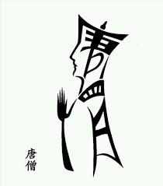
Notes:
Fun and Creative Character Exercise: Combine names of main roles and Chinese characters

Slide 4
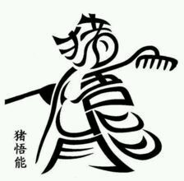

Slide 5
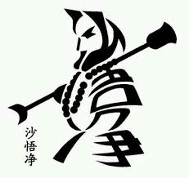

Slide 7
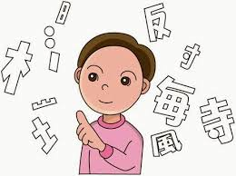
Activity 4.2 打气球
Pay attention to both the configuration and positions of the character components.
Notes:
Formative Assessment: Configuration of Characters + Position of Character Components

Slide 8
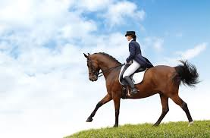
月
足
扌
彳
马

Slide 9
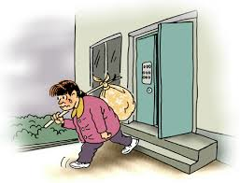
巾
月
心
天

Slide 10
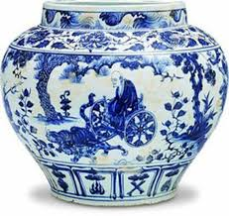
宀
广
重
忄
刂

Slide 11
生词小测
Vocabulary quiz via kahoot!
Notes:
Formative Assessment

Slide 12
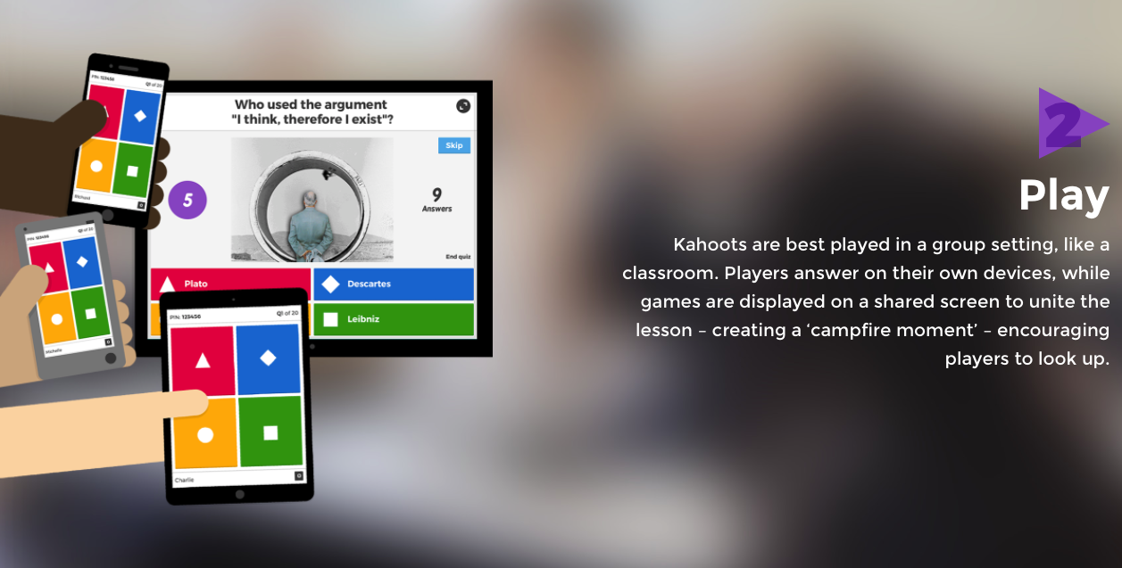
请你拿出手机或者电脑，
去kahoot.it，然后输入 号码，
游戏开始！

Slide 13
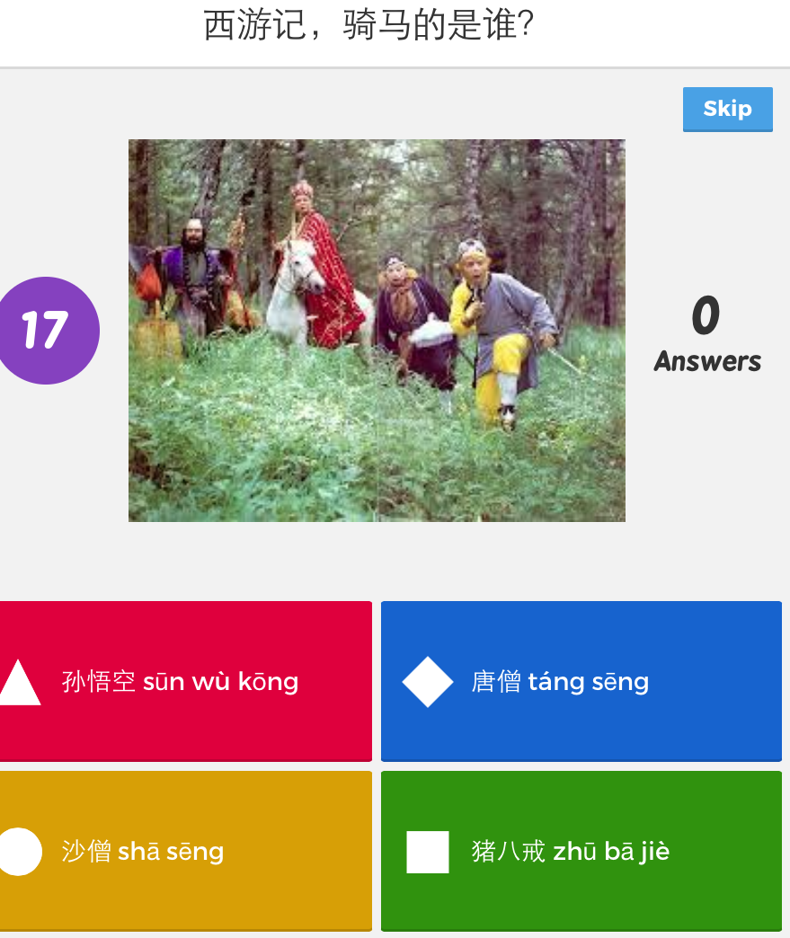

Slide 14
